Slide 1
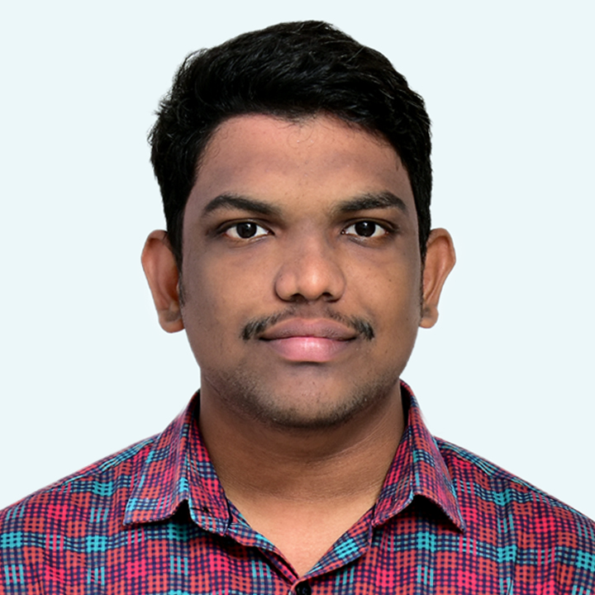




MEDAPATI APPAREDDY
Analyst/Software Engineer
Bachelor of Engineering
Electronics and Communications
2018- 2022
Skills
Bangalore
Java 8 /J2EE | Java Basics, OOPS, Collections, Arrays, Loops, Stream API Junit, Mockito.
Spring core | Dependency Injection, Autowire.
Spring REST | REST controllers, Implementation of GET, POST, PUT & DELETE, Controller & Repository layer.
Spring Data JPA | Implement DAO layer using spring Data repositories.
Spring Boot Microservices | Spring Boot Starters, annotations.
Spring Cloud | Eureka.
Angular | Components, Event handling.
React | Components, Hooks, Event handling.
Database | PostgreSQL
UI Tech | HTML 5 & CSS 3,JavaScript, ES6 & TypeScript Reusable templates, Optimized UI Designed
Tools | Git, Postman, VS Code, Eclipse.
Add On skills | Communications, Team management. Peer learning.
appareddy.medapati@capgemini.com
7658951626
A4
FULL STACK DEVELOPER
Hands on experience in creating Microservices and also Monolithic applications with Spring boot, Spring Cloud API Gateway, Eureka Discovery server.
Hands on experience in building web pages using HTML, CSS, Bootstrap, React and Angular.
Development experience using Eclipse, VS Code, Postman as API client, Pg Admin for Postgres Database.
Electricity Billing System Application
Completed end to end case study of Electricity Billing System with responsive UI with HTML, CSS and Angular used for user interface and PostgreSQL as the Database.
School Management Application
Developed backend applications using Monolithic Architecture and implemented all the CRUD operations using Spring Boot, Postgres, Postman and ReactJs for UI.
Certifications
Google Cloud Digital Leader Certification.
Microsoft Azure 900 Certification.
Check out my work on GitHub & Video Profile

